Slide 1
YouTube Data Harvesting
Present by
BALAJI R

Slide 2
Agenda
Synopsis
Existing system
Proposed system
Description of modules
Screenshots
Conclusion

Slide 3
SYNOPSIS :
The YouTube Data Harvesting is designed to efficiently collect and manage YouTube channel data for analysis and storage. This system integrates with the YouTube Data API to retrieve detailed information about channels, videos, and comments. Users can access and migrate the collected data into a PostgreSQL database through an intuitive Streamlit interface. The backend ensures seamless processing and storage, enabling users to analyze metrics like video performance and audience engagement. This project simplifies data handling for researchers and content creators, providing a centralized platform for YouTube analytics.

Slide 4
EXISTING SYSTEM :
The existing system for YouTube data harvesting is highly fragmented and lacks a unified approach. Users often rely on multiple tools or manual methods to collect and analyze data, which is time-consuming and inefficient. These systems do not provide an integrated platform to access comprehensive insights, making it challenging to gather, process, and utilize data effectively for analytics or content strategies.

Slide 5
PROPOSED SYSTEM :
The proposed system facilitates the automated collection and storage of YouTube data, providing detailed insights on channels, videos, and comments. By connecting to the YouTube API, it gathers key details like channel statistics, video metadata, and user comments. The collected data is stored in a PostgreSQL database, organized across separate tables for channels, videos, and comments. Users can easily migrate this data into the database by entering the channel ID. Additionally, the system allows users to perform SQL queries to gain insights, such as the most viewed videos or channels with the most content. The interface, built with Streamlit, ensures a user-friendly experience for data collection, migration, and analysis.

Slide 6
DESCRIPTION OF MODULES :
Libraries Used:
googleapiclient.discovery
pandas
psycopg2
Streamlit
Streamlit Interface:
Data Collection
Migrate to SQL
Channels
Queries
SQL Section
channels
videos
comments

Slide 7
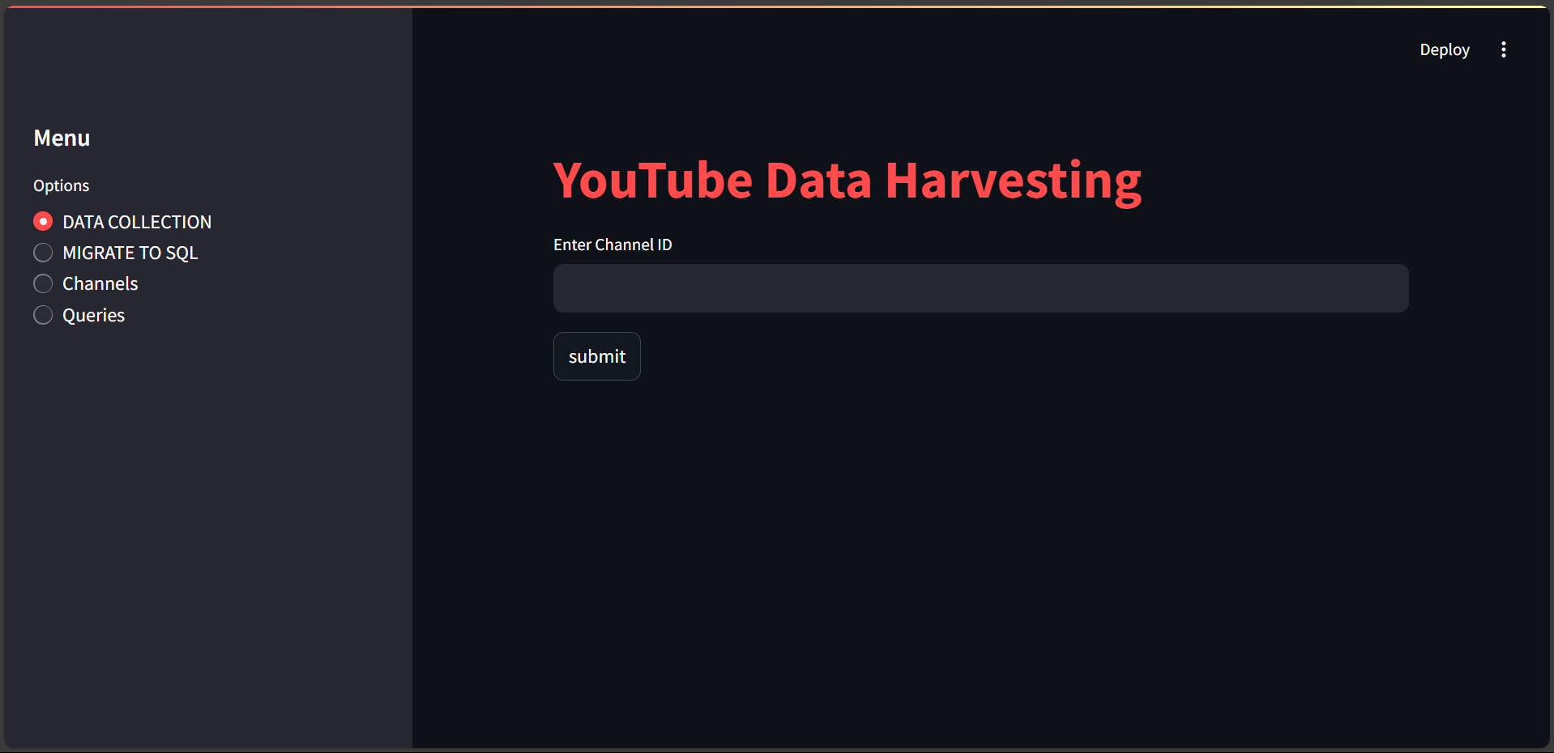
SCREENSHOTS:

Slide 8
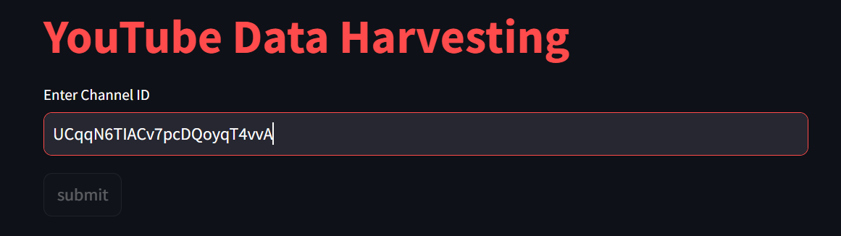
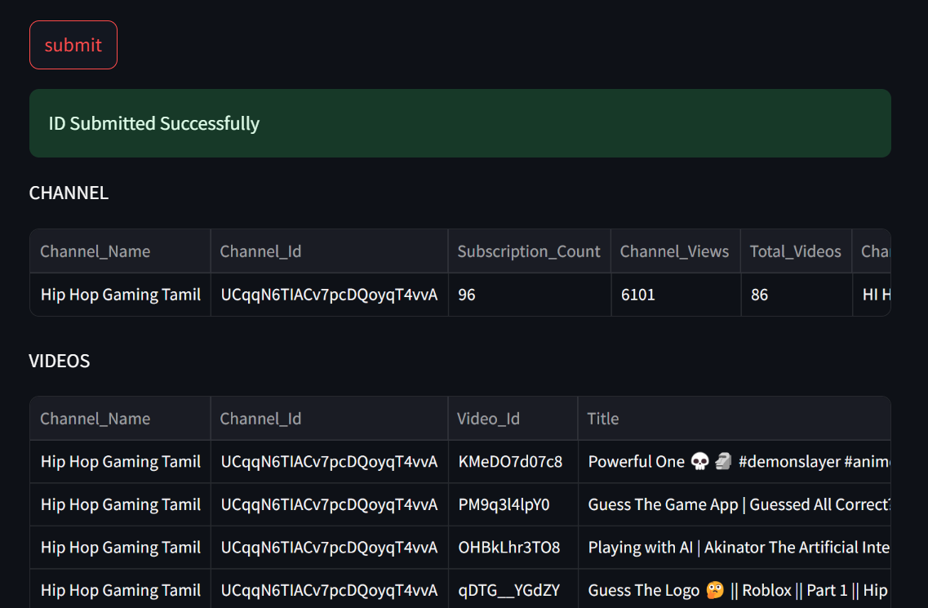

Slide 9
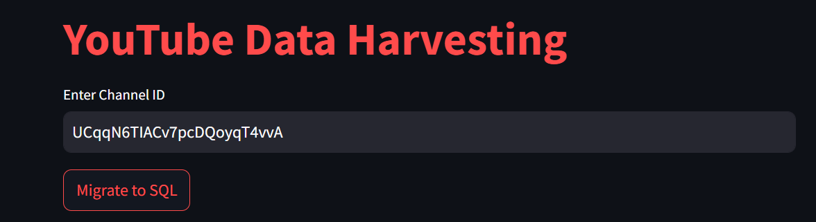
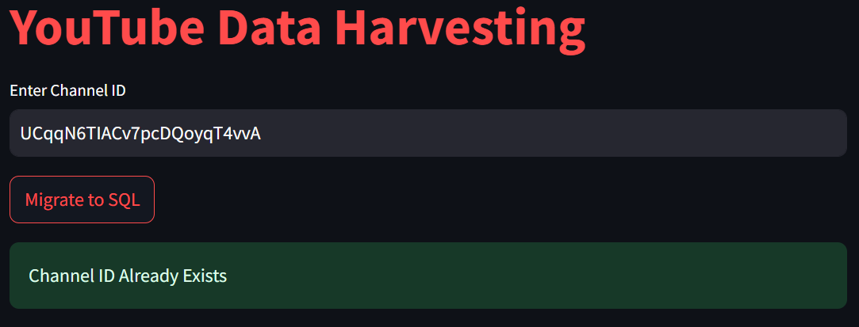

Slide 10
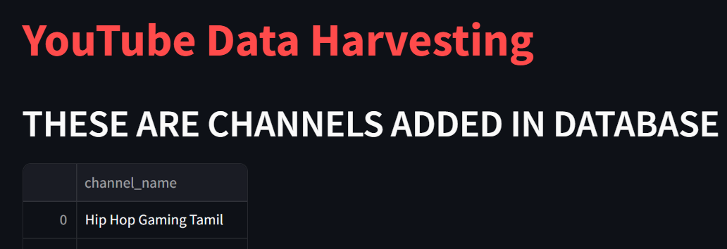

Slide 11
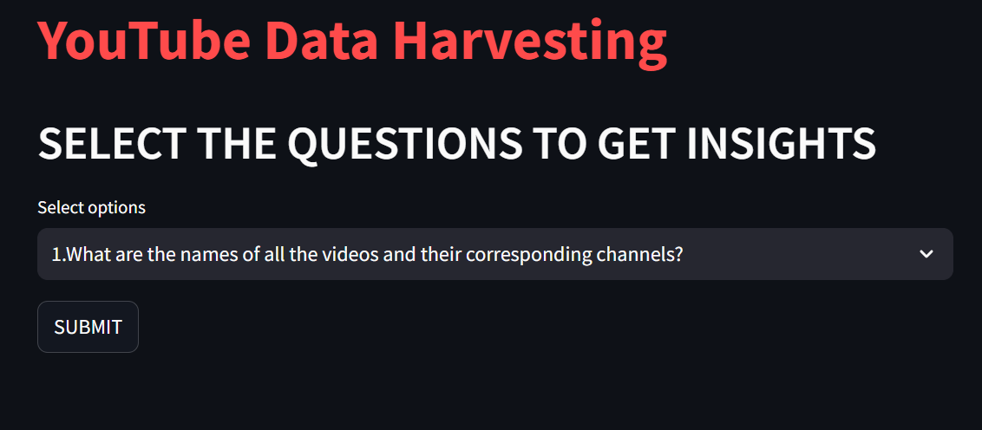
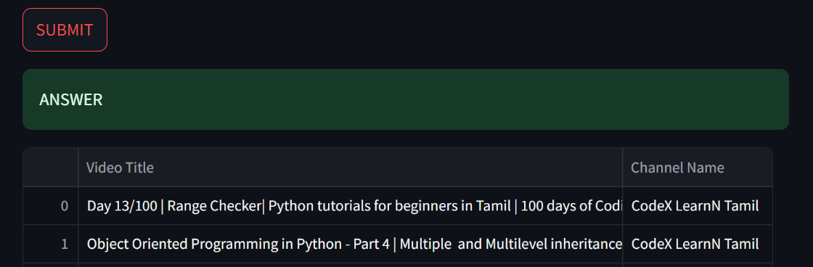

Slide 12
CONCLUSION :
This app allows users to collect, store, and analyze YouTube data efficiently. The integration with Streamlit provides an easy-to-use interface for interaction, and the SQL migration feature ensures the data can be persisted and queried as needed.

Slide 13
THANK YOU ALL
by BALAJI

